Slide 1
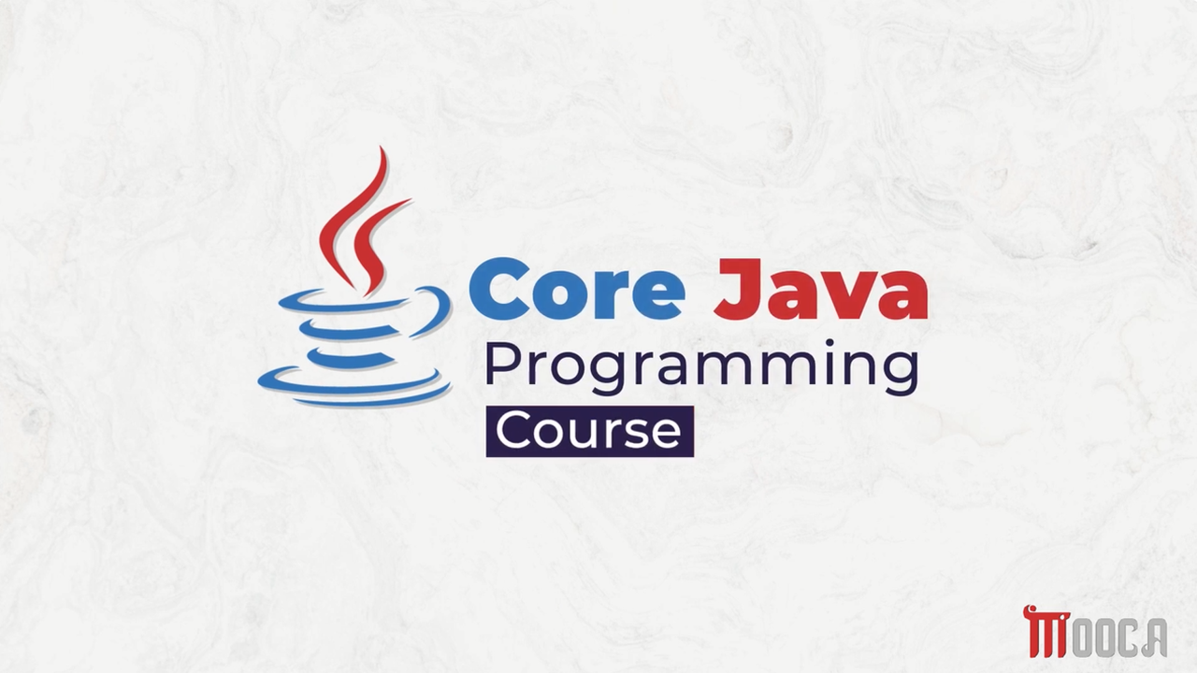

Slide 2
✍Lecture 8 :
Introduction to Generic Programming
Simple Generic Example Demo
Bounded Type Parameters
Wildcards
Lambda Expressions
Single Lambda Expressions
Block Lambda Expressions
Method Reference
Examples of Method Reference types

Slide 3
✍Lecture 9 :
Java collection
Iterators
Generic Utility Methods
Collection Framework interface
Linked Lists
Maps
Map Interface Method
Algorithms

Slide 4
✍Lecture 10 :
Stream API Introduction
Stream Operations
Common Intermediate & Terminal Stream Operations
Stream API Demo
Examples of Using Different Stream Operations
Method Types, Pipeline, and Different Operations
Advanced Collect
Input & Output Streams
Parallel Streams
Parallel Streams Demo

Slide 5
✍Java Stream API
Process and transform collections of data in a clean and declarative way
Introduced in Java 8
Provides a powerful way to process collections
Supports operations such as:
filter()
map()
sorted()
reduce()
collect()
Stream operations can be combined into a pipeline

Slide 6
✍What Is a Stream
A Stream represents a sequence of elements.
It allows us to process data from a source.
A stream does not store data.
A stream does not modify the original data source.
Streams support a sequence of operations to process data.

Slide 7
✍Collections vs Streams
Collection | Stream
Stores data | Processes data
Data-oriented | Computation-oriented
Can be modified | Does not modify the source
Can be traversed multiple times | Usually consumed once
Uses loops/iteration explicitly | Uses declarative operations

Slide 8
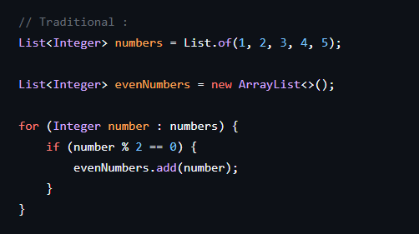
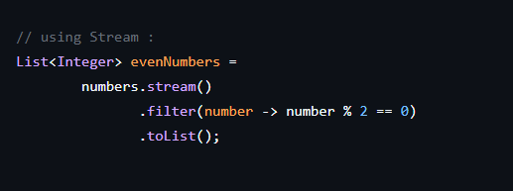





✍From Loop to Stream
Declarative Style

Slide 9
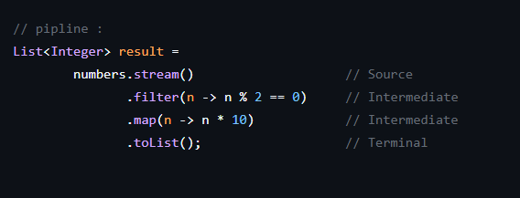




✍Stream Pipeline
A stream pipeline consists of:
Source → Intermediate Operations → Terminal Operation
Example:

Slide 10




✍Intermediate Operations
filter()
map()
sorted()
distinct()
limit()

Slide 11


✍Terminal Operation
toList()
collect()
count()
forEach()
reduce()

Slide 12



✍Intermediate vs Terminal Operations
Intermediate Operations
Return another Stream.
Terminal Operations
Produce a final result or side effect.
Intermediate operations build the pipeline. Terminal operations execute the pipeline.

Slide 13
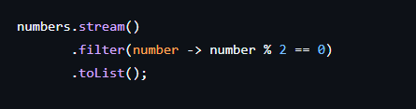



✍filter()
filter() is an intermediate operation.
It keeps only the elements that satisfy a condition.
The condition is represented by a Predicate.

Slide 14
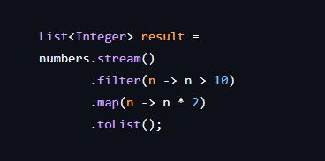


✍Combining Operations

Slide 15


✍sorted()
sorted() is an intermediate operation.
It returns a stream with elements in sorted order.
By default, natural ordering is used.

Slide 16


✍distinct()
Removes duplicate elements.
distinct() is an intermediate operation.
It keeps only unique elements.

Slide 17




✍limit()
limit(n) keeps only the first n elements.
It is an intermediate operation.
It can be useful for limiting large or infinite streams.

Slide 18


✍ peek()
peek() is an intermediate operation.
It allows us to observe elements as they pass through the pipeline.
It is mainly useful for debugging.

Slide 19
















✍Common terminal operations:
Terminal operations end the stream pipeline and trigger processing.
forEach()
findFirst()
anyMatch()
allMatch()
count()
reduce()
collect()
toList()

Slide 20
✍Employee Stream Example
We will work with a collection of employees and use Stream operations to:
Filter employees
Transform employee data
Sort employees
Collect the results

Slide 21
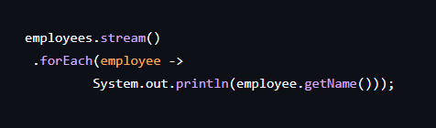

✍forEach() with Objects
Processing Objects with forEach()

Slide 22
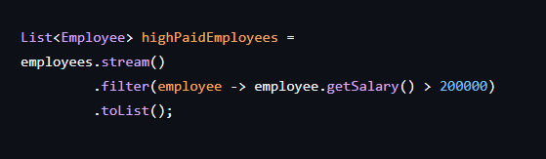

✍Filtering Employees by Salary

Slide 23
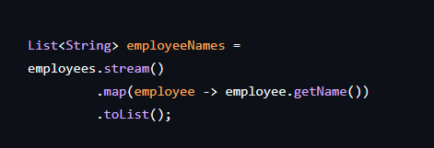



✍Mapping Employees to Names

Slide 24
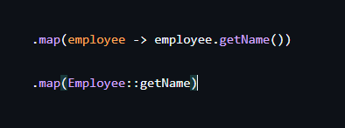

✍Method Reference
The following expressions are equivalent:

Slide 25
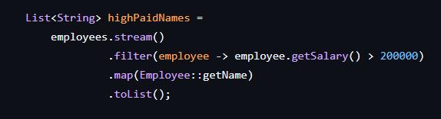

✍Filter Then Map

Slide 26
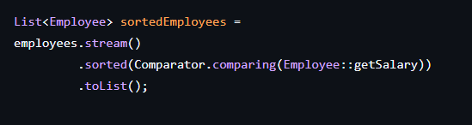

✍Sorting Employees

Slide 27
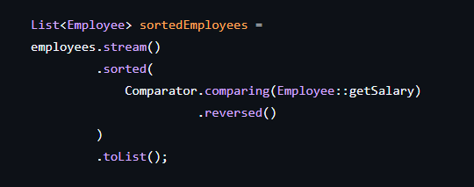

✍Sorting in Descending Order

Slide 28










✍Introducing Reduction Operations
A reduction operation combines multiple stream elements into one result.
count()
min()
max()
average()
sum()
reduce()

Slide 29
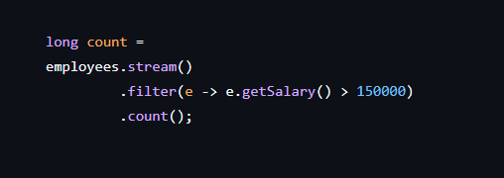



✍count()
count() returns the number of elements in the stream.

Slide 30
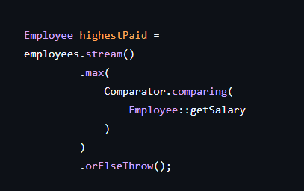


✍min() and max()

Slide 31
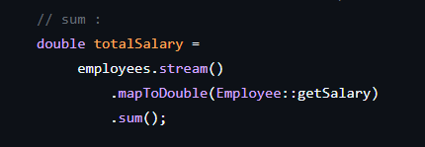
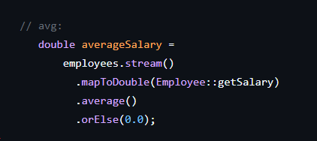







✍sum() and average()

Slide 32
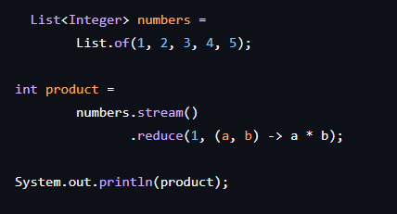








✍reduce()
reduce() combines all elements of a stream into a single result.

Slide 33
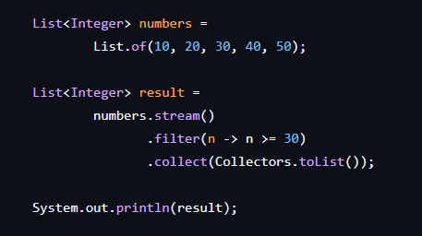





✍collect()
collect() is a terminal operation used to accumulate stream elements into a result.
Common results include:
List
Set
Map
String

Slide 34

✍summarizingDouble
summarizingDouble()
Collectors.summarizingDouble() calculates multiple statistics in one operation:
Count
Sum
Minimum
Maximum
Average

Slide 35
✍When Should We Use Parallel Streams?
Parallel streams can improve performance when:
The dataset is large.
Each element requires significant computation.
The operation can be safely executed in parallel.
The environment has multiple CPU cores.

Slide 36
✍Avoid blindly using parallel streams.
Consider:
Thread-safety
Ordering requirements
Shared mutable state
Overhead of parallelization

Slide 37
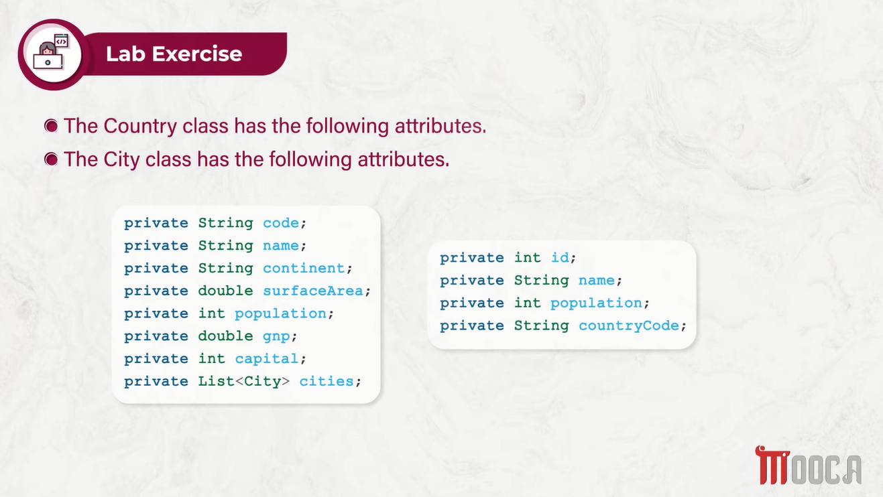

Slide 38
